Slide 1
GRAPHS
UNIT-4

Slide 2
INTRODUCTION
A data structure that consists of a set of nodes (vertices) and a set of edges that relate the nodes to each other
The set of edges describes relationships among the vertices
A graph G is defined as follows:
G=(V,E)
V(G): a finite, nonempty set of vertices
E(G): a set of edges e (pairs of vertices)
denoted by e=[u,v]

Slide 3
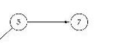
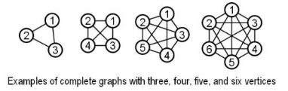
GRAPH THEORY TERMINOLOGY
Adjacent nodes: two nodes are adjacent if they are connected by an edge
Path: a sequence of vertices that connect two nodes in a graph
The length of a path is the number of edges on it.
simple path (simple directed path): a path in which all vertices, except possibly the first and the last, are distinct.
A cycle is a simple path in which the first and the last vertices are the same.
Simple cycle: cycle that does not pass through other vertices more than once
Complete graph: each pair of distinct vertices has an edge between them
5 is adjacent to 7
7 is adjacent from 5
If (v0, v1) is an edge in an undirected graph,
v0 and v1 are adjacent
The edge (v0, v1) is incident on vertices v0 and v1
V₀
V₁
0
0
0
1
2
1
2
1
2
3
3
3

Slide 4
GRAPH THEORY TERMINOLOGY
Connected graph
In an undirected graph G, two vertices, v₀ and v₁, are connected if there is a path in G from v₀ to v₁
An undirected graph is connected if, for every pair of distinct vertices v_{i}, v_{j}, there is a path from v_{i} to v_{j}
Strongly Connected Component
A directed graph is strongly connected if there is a directed path from vi to vj and also from vj to vi
strongly connected component
0
1

Slide 5
GRAPH THEORY TERMINOLOGY
undirected graph
Degree
The degree of a vertex is the number of edges incident to that vertex.
For directed graph
in-degree (v) : the number of edges that have v as the head
out-degree (v) : the number of edges that have v as the tail
3
0
3
1
2
3
3
3
G1
directed graph
0
in:1, out: 1
1
in: 1, out: 2
2
in: 1, out: 0
G3

Slide 6
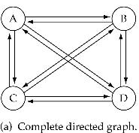
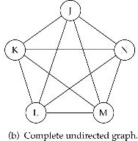
GRAPH THEORY TERMINOLOGY
What is the number of edges in a complete directed graph with N vertices?
N * (N-1)
What is the number of edges in a complete undirected graph with N vertices?
N * (N-1) / 2

Slide 7
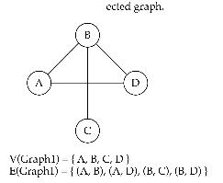
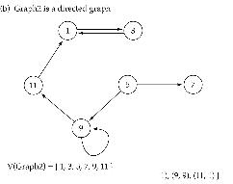
DIRECTED AND UNDIRECTED GRAPH
When the edges in a graph have no direction, the graph is called undirected
When the edges in a graph have a direction, the graph is called directed (or digraph)

Slide 8
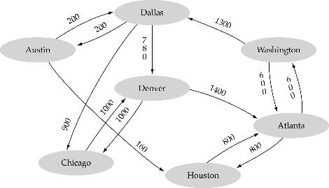
WEIGHTED GRAPH
Weighted graph: a graph in which each edge carries a value

Slide 9
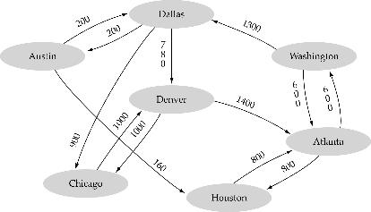
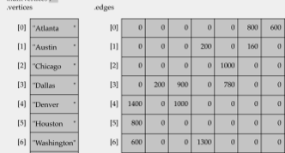
ARRAY BASED REPRESENTATION OF GRAPHS
A 1D array is used to represent the vertices
A 2D array (adjacency matrix) is used to represent the edges

Slide 10
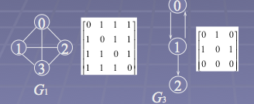
SEQUENTIAL REPRESENTATION OF GRAPHS
Adjacency Matrix
Let G = (V,E) be a graph with n vertices.
The adjacency matrix of G is a two-dimensional n x n array, say A=(a_{ij})
If the edge (vi, vj) is(not) in E(G), a_{ij}=1(0)
Matrix A is called BIT MATRIX

Slide 11
SEQUENTIAL REPRESENTATION OF GRAPHS
Merits of Adjacency Matrix
For an undirected graph, the degree of any vertex, i, is its row sum.
For a directed graph, the row sum is the out-degree, while the column sum is the in-degree.

Slide 12
SEQUENTIAL REPRESENTATION OF GRAPHS
Path Matrix
Let G be a simple directed graph with m nodes, v₁,v₂-------v_{m}. The path matrix is m-square matrix P=(p_{ij}) defined as follows:
P_{ij}= 1 ; if there is a path from v_{i} to v_{j}
0 ; otherwise
Consider the following graph:
The adjacency matrix A is:
Y
X
X
Y
Z
W
0 | 0 | 0 | 1
1 | 0 | 1 | 1
1 | 0 | 0 | 1
0 | 0 | 1 | 0
Z
W
X | Y | Z | W

Slide 13
SEQUENTIAL REPRESENTATION OF GRAPHS
The powers A²,A³ and A⁴ for the matrix A are:
A² considers paths of length 2
A³ considers paths of length 3
A⁴ considers paths of length 4 and so on…
The matrix A² is
The matrix A³ is
The matrix A⁴ is
0 | 0 | 1 | 0
1 | 0 | 1 | 2
0 | 0 | 1 | 1
1 | 0 | 0 | 1
1 | 0 | 0 | 1
1 | 0 | 2 | 2
1 | 0 | 1 | 1
0 | 0 | 1 | 1
0 | 0 | 1 | 1
2 | 0 | 2 | 3
1 | 0 | 1 | 2
1 | 0 | 1 | 1

Slide 14
If A is the adjacency matrix and P be the path matrix, then P_{ij}=1 if and only if there is a non zero number in the ij entry of the matrix.
Bm= A+A²+A³------A^{m}
The graph G in the above eg. contains 4 nodes, Therefore,
Replacing non zero entities in B₄,
we get path matrix P:
We obtain the following matrix B₄:
1 | 0 | 2 | 3
5 | 0 | 6 | 8
3 | 0 | 3 | 5
2 | 0 | 3 | 3
1 | 0 | 1 | 1
1 | 0 | 1 | 1
1 | 0 | 1 | 1
1 | 0 | 1 | 1
SEQUENTIAL REPRESENTATION OF GRAPHS

Slide 15
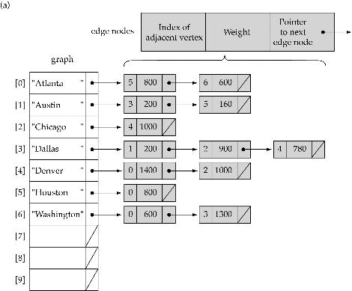

LINKED REPRESENTATION OF GRAPHS
A 1D array is used to represent the vertices
A list is used for each vertex v which contains the vertices which are adjacent from v (adjacency list)

Slide 16
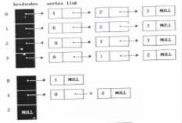
ADJACENCY LIST
Adjacency lists (LINKED REPRESENTATION)
There is one list for each vertex in G. The nodes in list i represent the vertices that are adjacent from vertex i.
degree of a vertex in an undirected graph
No. of nodes in adjacency list
out-degree of a vertex in a directed graph
No. of nodes in its adjacency list
0
0
1
1
2
3
2

Slide 17
LINKED REPRESENTATION OF GRAPHS
QUESTION 8.36

Slide 18
TRAVERSING A GRAPH
Many graph algorithms require a way to systematically examine the nodes and edges of a graph.
Two algorithm that we will be discussing are :
BFS- uses a queue to hold nodes for future processing
DFS- uses a stack to hold nodes for future processing.
During execution of the algorithm each node N will have one of the three states:
STATUS=1 ; Ready state
STATUS=2 ; waiting state (on queue or stack)
STATUS=3 ; processed state.

Slide 19
BREADTH-FIRST SEARCH
In this algorithm, we first examine the start node say A. then examine all the neighbours of A, then examine all the neighbours of neighbours of A and so on.
We need to keep track of the neighbours and ensure that no node is processed more than once.
This algorithm enable us to find the shortest path from source to destination.
BFS_ALGORITHM
1. Initialise all nodes to ready state i.e STATUS=1.
2. Put starting node A in queue and change its STATUS to waiting state i.e STATUS=2
3. Repeat steps 4 and 5 until queue is empty
4. Remove the front node of Queue and process it and change its STATUS=3.
5. add to queue all the neighbours of this node and change their status, STATUS=2.
End of step 3 loop
6. Exit

Slide 20
BREADTH-FIRST SEARCH
Question

Slide 21
DEPTH-FIRST SEARCH
In this algorithm, we first examine the start node say A. Then we examine each node along the path that begins at A i.e. we process a neighbour of A, then process the neighbour of neighbour of A and so on.
Once we reach a dead end e back track on this path and continue on a different path.
This algorithm is very similar to inorder traversal of a binary tree..
DFS_ALGORITHM
1. Initialise all nodes to ready state i.e STATUS=1.
2. Put starting node A on Stack and change its STATUS to waiting state i.e. STATUS=2
3. Repeat steps 4 and 5 until Stack is empty
4. Pop the top node of Stack and process it and change its STATUS=3.
5. Push to Stack all the neighbours of this node and change their status, STATUS=2.
End of step 3 loop
6. Exit

Slide 22
BREADTH-FIRST SEARCH
Question

Slide 23
SHORTEST PATH ALGORITHM-DIJKSTRA’S ALGORITHM
This algorithm finds the length of shortest path between two vertices.
Consider a weighted graph G=(V,E)
There are three things associated with every vertex of a graph:
Parent of a vertex; P(V)
Distance of the vertex; d(V)= W(U,V)+ d(U)
Where U and V are two vertices
W denotes the weight on the edge connecting these two vertices.
Color of the vertex, C(V) which can be:
White: C(V)=‘W’ ; when the vertex is not traversed.
Grey: C(V)=‘G’ ; when vertex is being processed.
Black: C(V)=‘B’ ; when all adjacent vertices are found.

Slide 24
SHORTEST PATH ALGORITHM-DIJKSTRA’S ALGORITHM
DIJKSTRA(G,S) Ref: CORMEN
{
For all v belonging to V
{
C(v)=‘W’
P(v)=nil
d(v)=∞
}
d(S)=0
Maintain a Queue Q and insert all the vertices in this queue
While(Q not empty)
{
u=extractmin(Q);
C(u)=‘G’
for all (v that are adjacent to u)
{
If (C(v)==‘W’)
{
If (d(v)>W(u,v)+d(u))
{
d(v)=W(u,v)+d(u)
P(v)=u
}}}
C(u)=‘B’
}

Slide 25
TABLES
TABLE: it is a data structure that is used to store information in tabular format.
Two types of tables that we will be discussing are:
Direct address tables
Hash tables

Slide 26
DIRECT ADDRESS TABLES
Consider a set of keys U={0,1,2,---------m-1}
Consider a table T such that T[0,1,2--------m-1] and each position in Array T corresponds to a key in U.
o
Slot containing element having key 2
1
2
m-1

Slide 27
HASH TABLE
Effective data structure for implementing dictionaries.
Elements having key K is stored in slot h(k).
Slot containing element having key h(2)
o
1
2
m-1

Slide 28
COLLISION
Sometimes elements hash to the same slot. This causes collision.
Slot containing element having key h(2)
o
1
Other element having key h(2)
2
m-1
Solution: put the
elements in a linked
List.

Slide 29
UNIT-6
SORTING ALGORITHMS

Slide 30
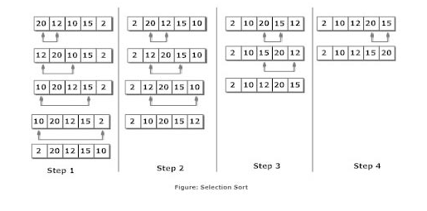
SELECTION SORT
SELECTION(A,N)
Set MIN=A[0]
LOC=0
Repeat for j=1 to N-1
if MIN>A[j]
Then set MIN=A[j]
And LOC=j
Now interchange A[0] and A[LOC] by taking a temp variable i.e.
Temp=A[0]
A[0]=A[LOC]
A[LOC]=temp
exit
Consider an array A of size N.
Let MIN store the minimum value in the array.
LOC stores the location of this element.
COMPLEXITY= O(n²)

Slide 31
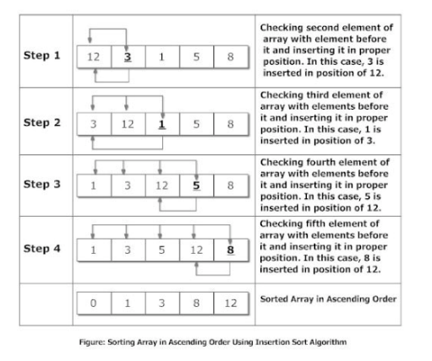
INSERTION SORT
INSERTION(A,N)
For (K=0 to N-1)
enter the elements of the array
For (i=1 to N-1)
temp=A[i]
PTR= i-1
While(temp<A[PTR])
A[PTR+1]=A[PTR]
PTR=PTR-1
End of while loop
Set A[PTR+1]=temp
exit
COMPLEXITY= O(n²)

Slide 32
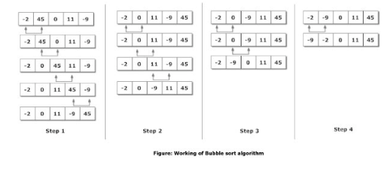
BUBBLE SORT
BUBBLESORT(A,N)
For (k=1 to N-1)
set PTR=0
while PTR<=N-k
if A[PTR]>A[PTR+1]
interchange them
set PTR=PTR+1
end of while
End of for loop
exit
COMPLEXITY= O(n²)

Slide 33
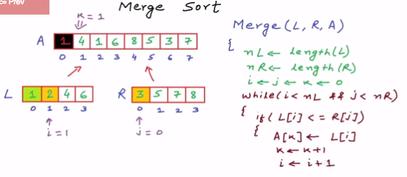
MERGE SORT
https://www.youtube.com/watch?v=TzeBrDU-JaY&noredirect=1

Slide 34
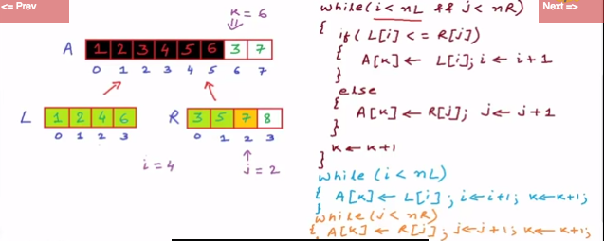
MERGE SORT

Slide 35
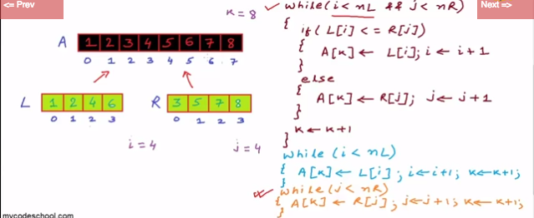
MERGE SORT

Slide 36
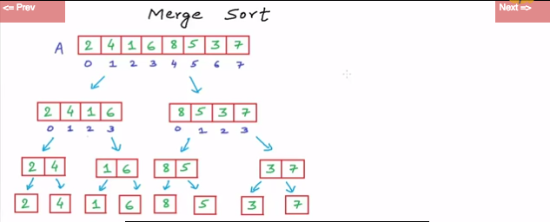
MERGE SORT

Slide 37
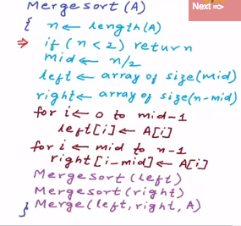
MERGE SORT

Slide 38
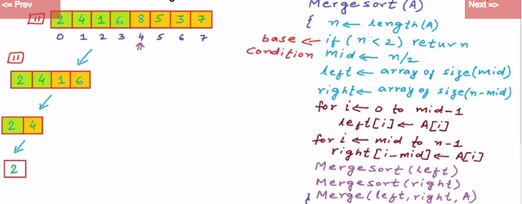
MERGE SORT

Slide 39
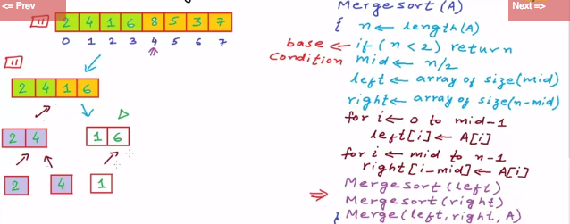
MERGE SORT

Slide 40
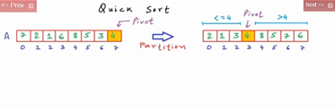
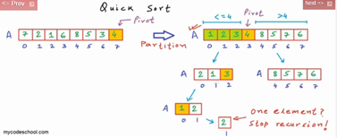
QUICK SORT

Slide 41
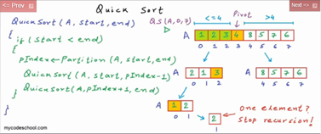
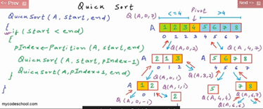
QUICK SORT

Slide 42
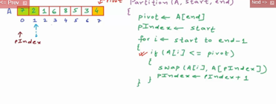
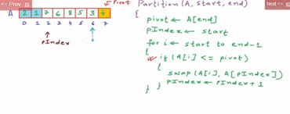
QUICK SORT

Slide 43
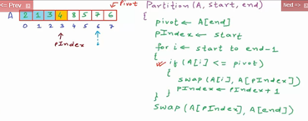
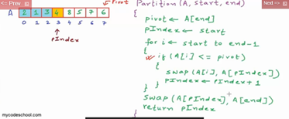
QUICK SORT

